Slide 1
Diabetes Infographics
Here is where your template begins

Slide 2
Diabetes infographic
Main types
Organs affected
Prevention
It’s the fifth planet from the sun and the largest in the solar system
It’s a gas giant with a radius of about nine times that on Earth
Symptoms
Treatment
It’s the fourth planet from the sun and it’s a cold place
It’s the eighth and farthest-known solar planet from the sun

Slide 3
Diabetes infographic
Neptune
Venus
It’s the farthest planet from the sun
Venus is the closest planet of the sun
Saturn
Uranus
It’s a gas giant and has several rings
Uranus is the seventh planet from the Sun
Earth
Pluto
Earth is the third planet from the sun
Pluto is a dwarf planet in the Kuiper belt

Slide 4
Diabetes infographic
Jupiter
Venus
Jupiter is the biggest planet of them all
It’s the closest planet
of the sun
Neptune
Earth
It’s the farthest planet from the sun
It’s the third planet
from the sun
Saturn
Mars
It’s a gas giant and has several rings
Despite being red, it’s actually a cold place

Slide 5
Diabetes infographic
Jupiter
Venus
Jupiter is the biggest planet of them all
It’s the closest planet
of the sun
Neptune
Earth
It’s the farthest planet from the sun
It’s the third planet
from the sun
Saturn
Mars
It’s a gas giant and has several rings
Despite being red, it’s actually a cold place

Slide 6
Diabetes infographic
Jupiter
Saturn
Neptune
Jupiter is the biggest planet of them all
It’s a gas giant and has several rings
It’s the farthest planet from the sun
Venus
Mars
It’s the closest planet
of the sun
Despite being red, it’s actually a cold place

Slide 7
Diabetes infographic
Jupiter
Venus
Jupiter is the biggest planet of them all
It’s the closest planet
of the sun
Neptune
Earth
It’s the farthest planet from the sun
It’s the third planet
from the sun
Saturn
Mars
It’s a gas giant and has several rings
Despite being red, it’s actually a cold place

Slide 8
Diabetes infographic
Earth
It’s the third planet
from the sun
Jupiter
Mars
Neptune
Jupiter is the biggest planet of them all
Despite being red, it’s actually a cold place
It’s the farthest planet from the sun
Diabetes data
1995
60%
Saturn
2000
It’s a gas giant with an average radius of about nine times that on Earth
88%
2005
2000
2005
2010
2015
30%
Venus is the closest planet to the sun
2010
Uranus is the seventh planet from the Sun
46%

Slide 9
Diabetes infographic
Jupiter
Venus
Jupiter is the biggest planet of them all
It’s the closest planet
of the sun
Neptune
Earth
It’s the farthest planet from the sun
It’s the third planet
from the sun
Saturn
Mars
It’s a gas giant and has several rings
Despite being red, it’s actually a cold place

Slide 10
Diabetes infographic
2
4
Mars
Venus
Despite being red, it’s actually a cold place
Venus is the closest planet to the sun
1
3
5
Jupiter
Saturn
Neptune
Jupiter is the biggest planet of them all
It’s a gas giant and has several rings
It’s the farthest planet from the sun

Slide 11
Diabetes infographic
2.9M
TREATMENT
Jupiter is the biggest planet of them all
Saturn
Earth is the only known planet to harbor life
Venus is the closest planet to the sun
It’s a gas giant and has several rings
AREAS AFFECTED
Neptune
It’s the farthest planet from the sun
Kidney
Heart
Sight
Brain
Feet
Ears

Slide 12
Diabetes infographic
Venus
1
It’s the closest planet to the sun
Mars
2
It’s actually a really cold place
Earth
3
Earth is the third planet from the sun
Jupiter
4
It’s the biggest planet of them all
Neptune
5
It’s the farthest planet from the sun

Slide 13
Diabetes infographic
Symptoms
Treatment
Dizziness
Take medicine
It’s the closest planet to the sun
Earth is the third planet from the sun
Fatigue
Eat healthy
Earth is the third planet from the sun
It’s the farthest planet from the sun
Weight loss
Monitor
It’s the farthest planet from the sun
It’s a gas giant and has several rings

Slide 14
Diabetes infographic
Jupiter
Neptune
Jupiter is the biggest planet of them all
It’s the closest planet
of the sun
Mars
Earth
It’s the farthest planet from the sun
Avoid
Enjoy
It’s the third planet
from the sun
Saturn
Venus
It’s a gas giant and
has several rings
Despite being red, it’s actually a cold place

Slide 15
Diabetes infographic
Venus
It’s the closest planet to the sun
Mars
It’s actually a really cold place
Earth
Earth is the third planet from the sun
Jupiter
It’s the biggest planet of them all
Neptune
It’s the farthest planet from the sun

Slide 16
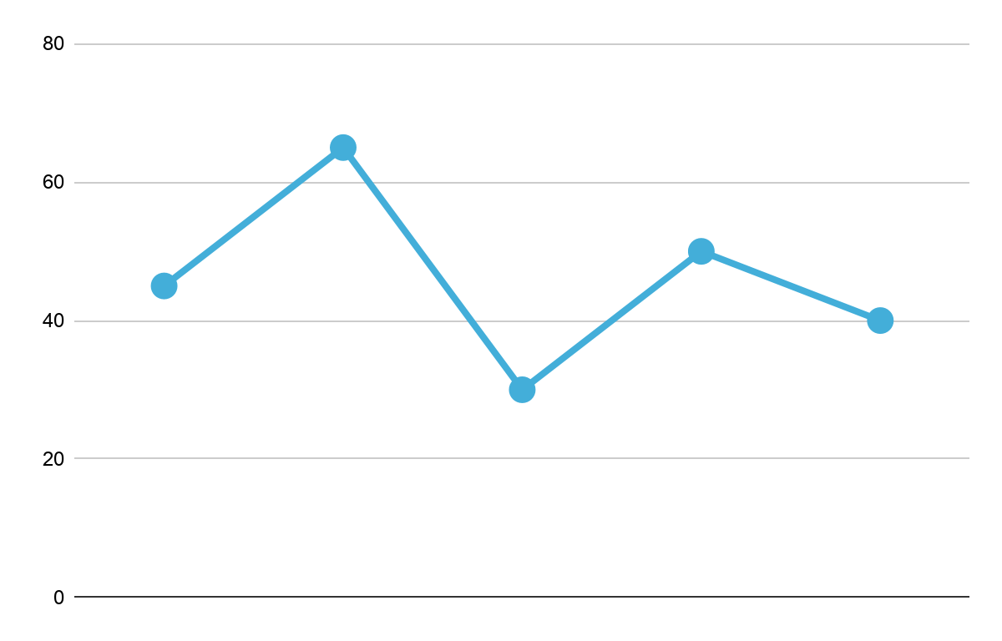
Diabetes infographic
Earth
Saturn
Earth is the third planet from the sun
Saturn is the sixth planet from the Sun and the second-largest in the Solar System, after Jupiter.
75%
Neptune
It’s the farthest planet from the sun
65%
Jupiter
40%
50%
40%
It’s the fifth planet from the sun and the largest in the solar system
30%
Venus
It’s the closest planet to the sun

Slide 17
Diabetes infographic
33%
25%
Jupiter is the biggest planet of them all
It’s the closest planet
of the sun
14%
28%
It’s the farthest planet from the sun
It’s the third planet
from the sun
14%
14%
It’s a gas giant and has several rings
Despite being red, it’s actually a cold place

Slide 18
Diabetes infographic
What is diabetes?
How is it diagnosed?
What are the symptoms?
Saturn is the sixth planet from the Sun and the second-largest in the Solar System, after Jupiter.
Saturn is the sixth planet from the Sun and the second-largest in the Solar System, after Jupiter.
Fatigue
Tingling
No healing
Weight lose

Slide 19
Diabetes infographic
Saturn
25%
It’s a gas giant with an average radius of about nine times that on Earth
INSULIN
Jupiter
It’s the fifth planet from the sun and the largest in the solar system
75%

Slide 20
Diabetes infographic
SYMPTOMS
DIABETES STATS
Slow healing
Sweating
It’s a gas giant with an average radius of about nine times that on Earth
Venus
Saturn
Sugar control
Thirst
Mars

Slide 21
Diabetes infographic
55%
Symptoms
Saturn is the sixth planet from the Sun and the second-largest in the Solar System, after Jupiter.
50%
Weight loss
65%
Thirst
75%
Fatigue
Prevention and treatment
Illness increase
1995
60%
2000
40%
2005
70%
Healthy food
Exercise
Insulin
2010
20%

Slide 22
Diabetes infographic
Jupiter
Venus
Jupiter is the biggest planet of them all
It’s the closest planet
of the sun
Neptune
Earth
It’s the farthest planet from the sun
It’s the third planet
from the sun
Saturn
Mars
It’s a gas giant and has several rings
Despite being red, it’s actually a cold place

Slide 23
Diabetes infographic
Affects of Diabetes
Percentages
Eye disease
75%
50%
Heart disease
Jupiter
Saturn
Kidney disease
70%
Saturn
Nerve damage
90%
Jupiter
55%
Venus
Feet damage
75%
Uranus

Slide 24
Diabetes infographic
Saturn
Neptune
It’s a gas giant with an average radius of about nine times that on Earth
It’s the eighth and farthest-known solar planet from the sun
Jupiter
Mars
It’s the fifth planet from the sun and the largest in the solar system
It’s the fourth planet from the sun and it’s
a cold place
Saturn
Venus
Venus
Venus is the second, closest and brightest planet from the sun
Uranus

Slide 25
Diabetes infographic
14%
Saturn
33%
A
Saturn is the sixth planet from the Sun and the second-largest in the Solar System, after Jupiter.
25%
Venus
Mars
28%
Pluto
0
B
It’s a gas giant and has several rings
It’s the farthest planet to the sun
Jupiter is the biggest planet of them
Venus is the closest planet of the sun

Slide 26
Diabetes infographic
Jupiter
Jupiter is the biggest planet of them all
Prevention
Neptune
It’s the farthest planet from the sun
Pluto is the ninth planet from the sun
Uranus is seventh planet from the sun
Saturn
It’s a gas giant and has several rings
Treatment
Venus
Venus is the closest planet of the sun
Despite being red, it’s actually a cold place
It’s the biggest planet of them all

Slide 27
Diabetes infographic
Saturn
Jupiter
It’s a gas giant and has several rings
Jupiter is the biggest planet of them all
Uranus
Mars
Uranus is the seventh planet from the Sun
It’s a gas giant and has several rings
Earth
Venus
It’s the third planet from the sun
Venus is the closest planet of the sun

Slide 28
Diabetes infographic
Symptoms
Prevention
Wounds heal slowly
High blood sugar
Weight
Healthy
Exercise
Treatment
Always
thirsty
Extreme fatigue
Insuline
Medicine
Control

Slide 29
Diabetes infographic
Hydration
Type
Jupiter is the biggest planet of them all
Venus is the closest planet of the sun
Evolution
Medicine
It’s the farthest planet from the sun
Uranus is seventh planet from the sun
World Stats
Diet
It’s a gas giant and has several rings
Pluto is the ninth planet from the sun

Slide 30
Diabetes infographic
Jupiter
It’s the fifth planet from the sun and the largest in the solar system
Mars
25%
5.8
It’s the fourth planet from the sun and it’s a cold place
75%
Saturn
It’s a gas giant with an average radius of about nine times that on Earth

Slide 31
Diabetes infographic
8.5
Jupiter
Venus
Jupiter is the biggest planet of them all
Venus is the closest planet of the sun
Neptune
Uranus
It’s the farthest planet from the sun
Uranus is seventh planet from the sun

Slide 32
Instructions for use
In order to use this template, you must credit Slidesgo and Freepik in your final presentation and include links to both websites.
You are allowed to:
- Modify this template.
- Use it for both personal and commercial projects.
You are not allowed to:
- Sublicense, sell or rent any of Slidesgo Content (or a modified version of Slidesgo Content).
- Distribute Slidesgo Content unless it has been expressly authorized by Slidesgo.
- Include Slidesgo Content in an online or offline database or file.
- Offer Slidesgo templates (or modified versions of Slidesgo templates) for download.
- Acquire the copyright of Slidesgo Content.
For more information about editing slides, please read our FAQs or visit Slidesgo School:
https://slidesgo.com/faqs and https://slidesgo.com/slidesgo-school

Slide 33
Infographics
You can add and edit some infographics to your presentation to present your data in a visual way.
Choose your favourite infographic and insert it in your presentation using Ctrl C + Ctrl V or Cmd C + Cmd V in Mac.
Select one of the parts and ungroup it by right-clicking and choosing “Ungroup”.
Change the color by clicking on the paint bucket.
Then resize the element by clicking and dragging one of the square-shaped points of its bounding box (the cursor should look like a double-headed arrow). Remember to hold Shift while dragging to keep the proportions.
Group the elements again by selecting them, right-clicking and choosing “Group”.
Repeat the steps above with the other parts and when you’re done editing, copy the end result and paste it into your presentation.
Remember to choose the “Keep source formatting” option so that it keeps the design. For more info, please visit Slidesgo School.

